Slide 1


Likhitha K
WEB DEVELOPMENT AND DESIGNING INTERN
AT
THE SPARK FOUNDATION

Slide 2


Slide 3
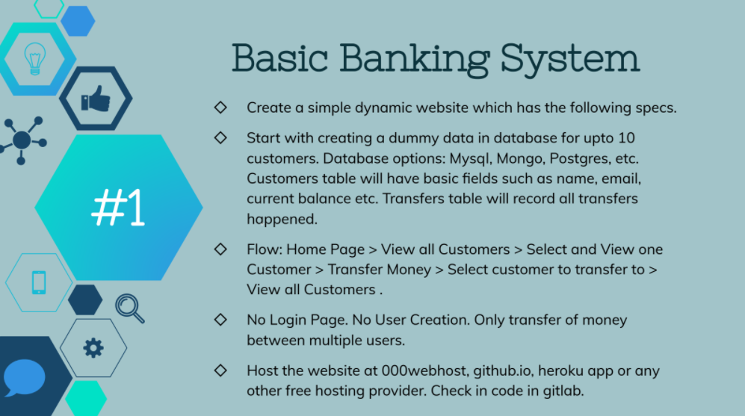

Slide 4
A Web Application used to transfer money between multiple users.
Stack used :-
Front-end : HTML, CSS, Bootstrap & Javascript
Back-end : PHP
Database : MySQL Database
Flow of the Website: Home Page > View all Users > Select and View one User >
Transfer Money > Select receiver > View all Users > View Transfer History.

